Slide 1

OCR Project
(Optical Character Recognition Project for Patient Feedback forms)

Slide 2

Introduction
Currently, feedback forms for stroke patients are handled manually. This project uses OCR technology to automate data extraction, reducing manual effort and improving data accuracy. Automating this process ensures faster and more reliable analysis of patient feedback, leading to better-informed decisions in patient care.

Slide 3
Objectives
Automate Data Extraction: Streamline feedback form processing.
Improve Accuracy: Reduce errors with AI-driven tools.
Boost Efficiency: Speed up data processing and analysis.
Scalability: Handle large volumes of forms effectively.
Leverage AWS Services: Use Amazon Textract for OCR and AWS Bedrock for advanced text analysis.

Slide 4

AWS resources used
What is AWS?
A cloud computing platform offering a wide range of scalable and flexible services.
Amazon S3: Storage for input forms and extracted data.
AWS Lambda: Serverless processing for data extraction and handling.
Amazon DynamoDB: Storage for structured data.
Amazon SQS: Message queuing for processing workflows.
Amazon SNS: Notifications and alerts.
Amazon Textract: OCR for extracting data from forms.
AWS Bedrock: Advanced AI for complex text analysis.

Slide 5

Approaches overview
Amazon Textract
Uses OCR to automatically extract text and data from scanned feedback forms.
Ideal for extracting key-value pairs, tables, and handwritten text.
Amazon Bedrock
Provides advanced AI models for deeper text analysis.
Enhances data extraction by interpreting context and complex structures in forms.

Slide 6
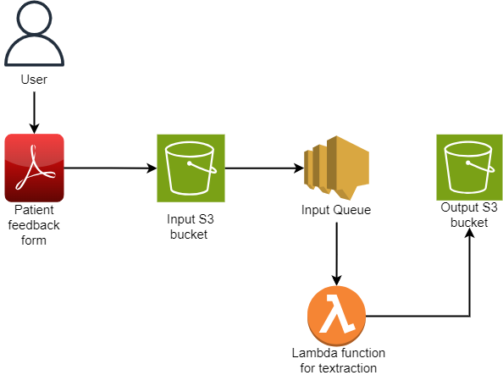
Amazon Textract workflow

Slide 7

Amazon Textract pros & cons
Pros:
Automated OCR: Extracts text from scanned documents, including handwritten text.
Structured Data: Provides key-value pairs and tables.
Easy Integration: Works well with AWS services like S3, Lambda, and DynamoDB.
Scalable: Efficient with large volumes of documents.
Cons:
Accuracy Variability: Depends on document quality and handwriting.
Limited Context: May struggle with complex or nuanced data.

Slide 8
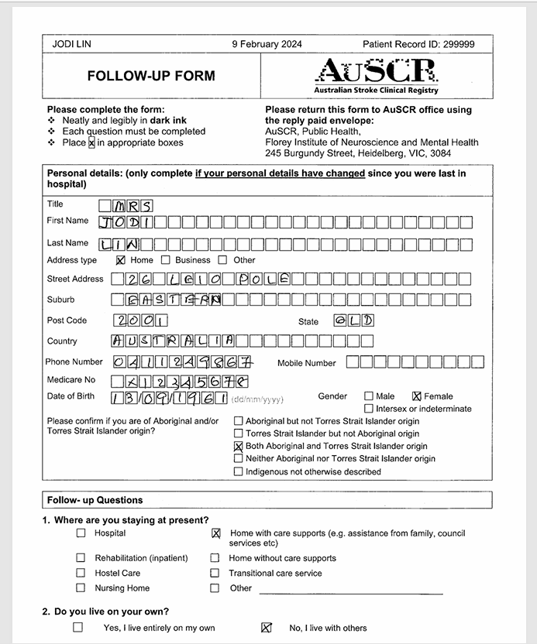

Slide 9
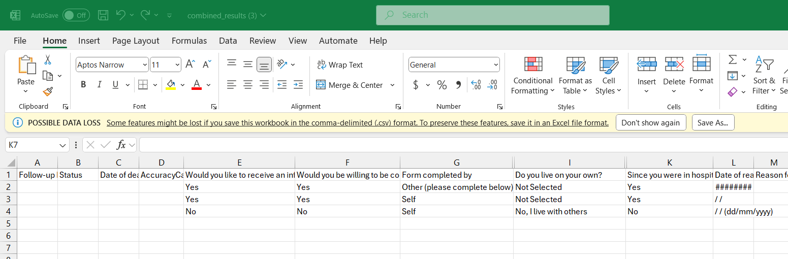

Slide 10
Original Data
Title - MRS
First Name - JODI
Last Name - LIN
Street Address - 26 LELO POLE
Suburb - EASTERN
Post Code - 2001
State - QLD
Country - AUSTRALIA
Phone Number - 0411249867
Mobile Number - not filled
Medicare No - X12345678
Date of Birth - 13 / 09/ 1961
Hospital - Logan
YOUR HEALTH TODAY - 55
Patient Record ID - 299999
Extracted Data
Title - MRS
First Name - JODI
Last Name - LIN
Street Address - 26 LE10 POLE
Suburb - EASTERN
Post Code - 2001
State - QLD
Country - AUSTRALIA
Phone Number - 0411249867
Mobile Number -
Medicare No - X12345678
Date of Birth - 13 / 091196
Hospital - Logan
YOUR HEALTH TODAY - 55
Patient Record ID - 299999

Slide 11
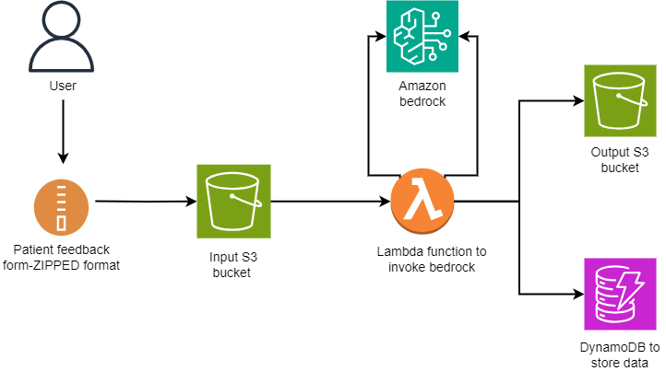
Amazon Bedrock Workflow

Slide 12

Amazon Bedrock pros & cons
Pros:
Advanced AI Models: Provides deep text analysis and contextual understanding.
Rich Insights: Offers more detailed data interpretations.
Cons:
Complex Setup: Requires more configuration and setup.
Processing Time: May be slower due to advanced analysis.

Slide 13
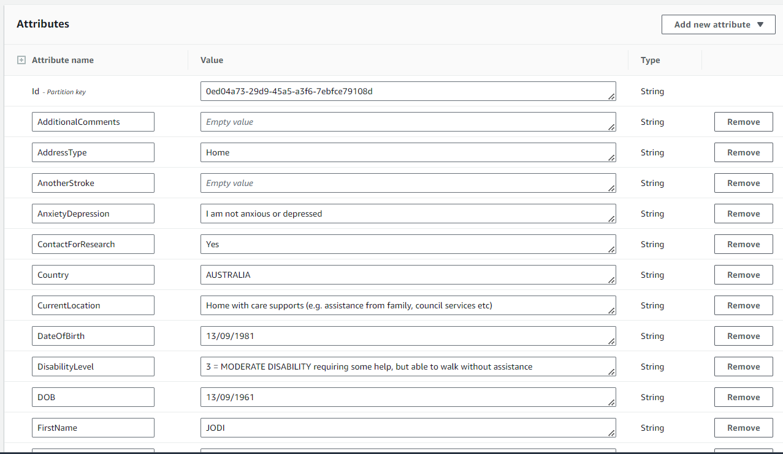

Slide 14
Original Data
Title - MRS
First Name - JODI
Last Name - LIN
Street Address - 26 LELO POLE
Suburb - EASTERN
Post Code - 2001
State - QLD
Country - AUSTRALIA
Phone Number - 0411249867
Mobile Number - not filled
Medicare No - X12345678
Date of Birth - 13 / 09/ 1961
Hospital - Logan
YOUR HEALTH TODAY - 55
Patient Record ID - 299999
Extracted Data
Title - MRS
First Name - JODI
Last Name - LIN
Street Address - 246 LEICESTER POLE
Suburb - EASTERN
Post Code - 2001
State - QLD
Country - AUSTRALIA
Phone Number - 0411241327
Mobile Number - not filled
Medicare No - X12345678
Date of Birth - 13 / 09/ 1971
Hospital - Logan
YOUR HEALTH TODAY - 55
Patient Record ID - 299999

Slide 15
Textract vs Bedrock Comparative Analysis
Which do you think is the better approach for your needs?

Slide 16
Textract data
Title - MRS
First Name - JODI
Last Name - LIN
Street Address - 26 LE10 POLE
Suburb - EASTERN
Post Code - 2001
State - QLD
Country - AUSTRALIA
Phone Number - 0411249867
Mobile Number -
Medicare No - X12345678
Date of Birth - 13 / 091196
Hospital - Logan
YOUR HEALTH TODAY - 55
Patient Record ID - 299999
Bedrock Data
Title - MRS
First Name - JODI
Last Name - LIN
Street Address - 246 LEICESTER POLE
Suburb - EASTERN
Post Code - 2001
State - QLD
Country - AUSTRALIA
Phone Number - 0411241327
Mobile Number - not filled
Medicare No - X12345678
Date of Birth - 13 / 09/ 1971
Hospital - Logan
YOUR HEALTH TODAY - 55
Patient Record ID - 299999

Slide 17
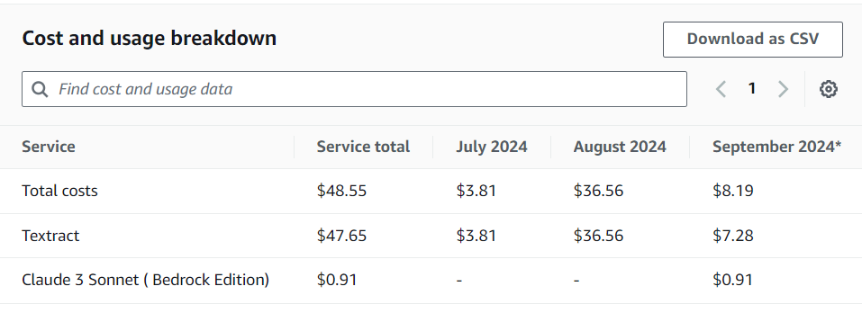
Cost Analysis of AWS Textract and Bedrock.

Slide 18
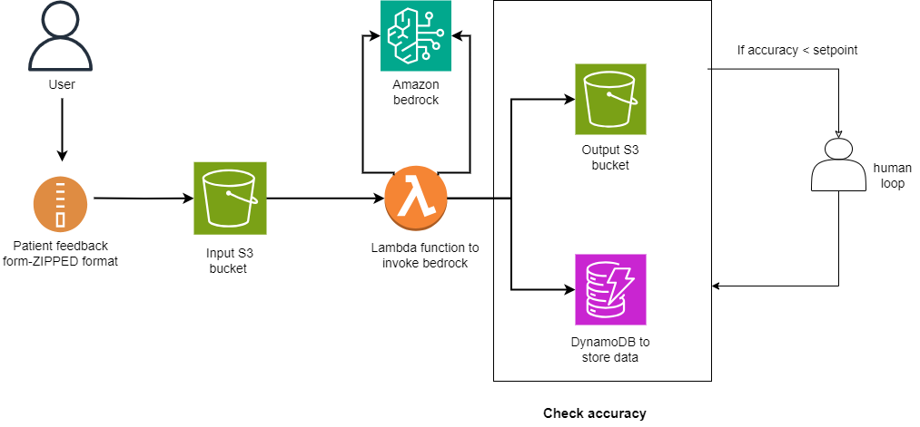
What’s Next? Human in the Loops?

Slide 19
Adding Human-in-the-Loop
Allows manual review and feedback on extracted data.
Improves accuracy and decision-making.
How it Enhances Accuracy
Combines human expertise with AI systems.
Ensures better precision in unclear data or complex documents.

Slide 20
Thank you!

